Slide 1
US Traffic Accidents: A Data-Driven Approach to Understanding Road Risks
Anshu Reddy Dhamana, Brendan Chao, Sri Gopi Sarath Gode, Srithareddy Devireddy, Vinuthna Papana
Group 5

Slide 2
Background and Project Goal:
In the United States, public safety and infrastructure are both greatly impacted by traffic accidents.
A comprehensive analysis into the variables that cause traffic accidents will allow policymakers to make the correct, informed decision.
Goal: Create interactive, data-driven dashboards to visualize traffic accident data
Identify geographic hotspots, assess weather and road conditions, and evaluate trends over time.
Provide actionable insights for emergency responders, lawmakers, and urban planners.

Slide 3
Dataset:
Source: Kaggle’s US Accidents (2016 - 2023) dataset.
https://www.kaggle.com/datasets/sobhanmoosavi/us-accidents?resource=download
Scope: Contains over 7 million records of traffic accidents across the U.S., covering a wide geographic area and time range.
Key Variables of Interest:
Severity: Scale of 1 to 4, where higher numbers represent more severe accidents.
Location Attributes: City, county, state, zip code, street, latitude, longitude, providing spatial context.
Time and Date: Accident time, day, month, and year for time-based analysis.
Weather Conditions: Variables like temperature, humidity, wind speed, and precipitation types (rain, snow, fog) that are relevant to accident causes.

Slide 4
Tools:
Python and Power Query: Preprocessing, handling missing data, and transforming columns.
PowerBI: Interactive dashboards/visualizations and exploratory data analysis to identify patterns and trends in the dataset.

Slide 5
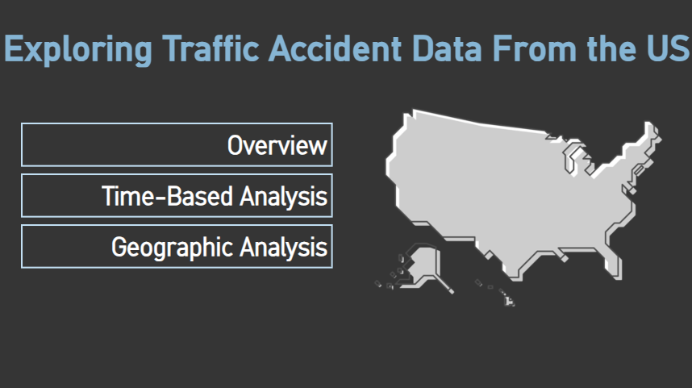
Title Dashboard

Slide 6
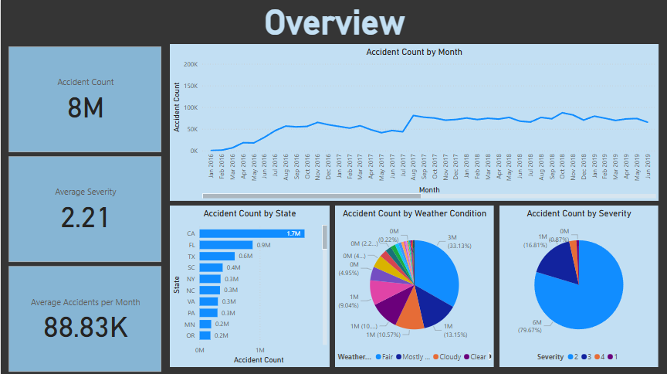
Overview Dashboard

Slide 7
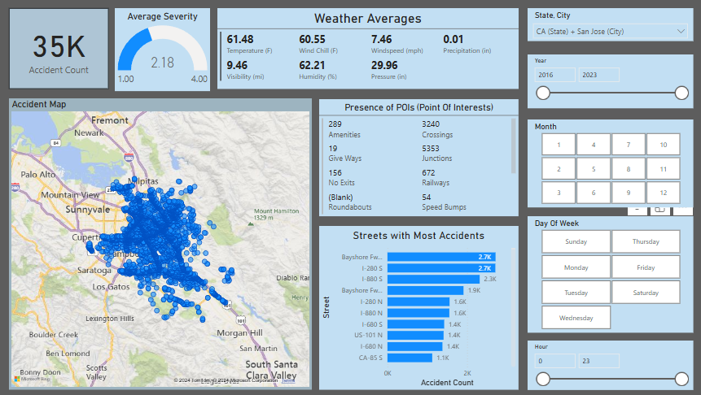
Time-based Dashboard

Slide 8
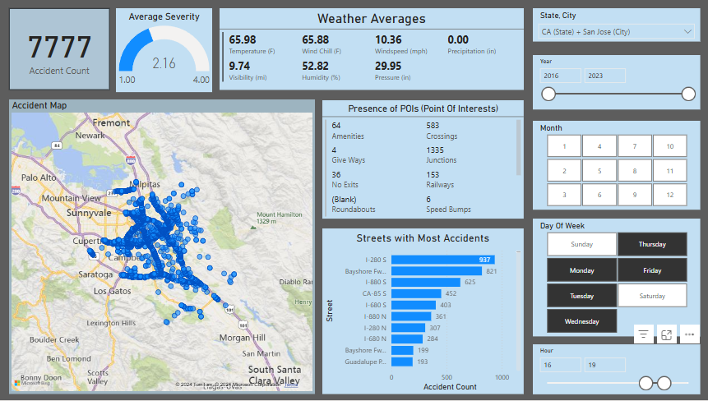
Time-based Dashboard: sliced by M-F, 4-8PM

Slide 9
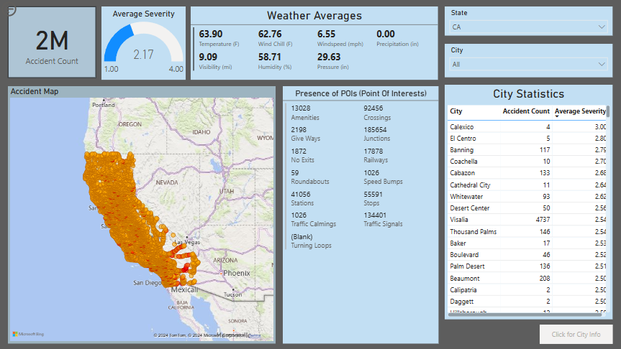
Geographic Dashboard

Slide 10
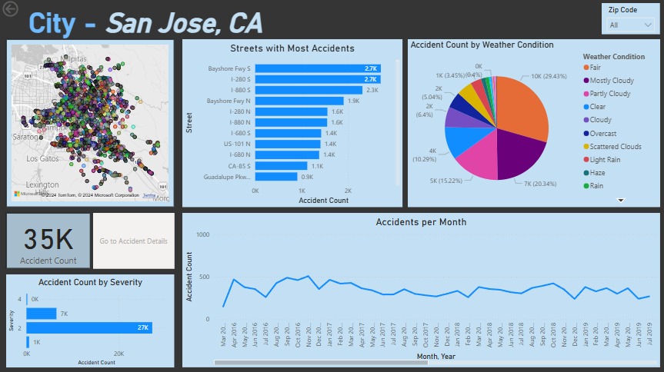
City Dashboard

Slide 11
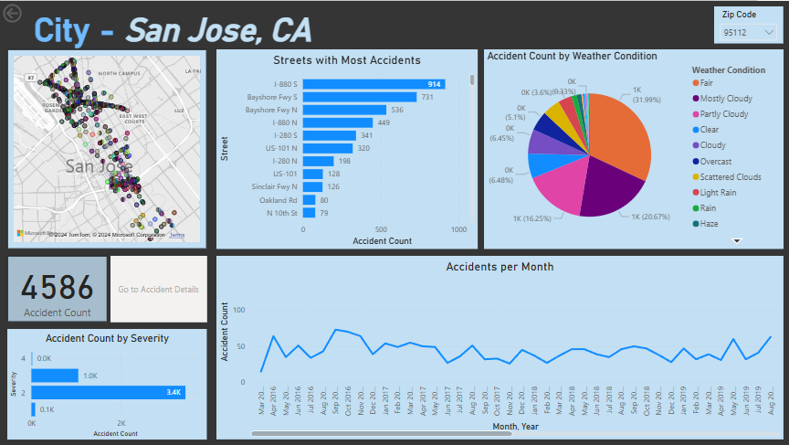
City Dashboard: sliced by zip code (95112)

Slide 12
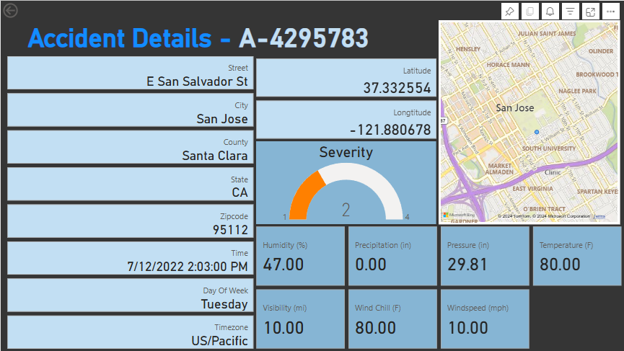
Accident Details Dashboard

Slide 13
Discussion - Key Findings
Geographic Hotspots
Certain cities and states have disproportionately higher accident rates than others
Can be seen through high clustering around cities on maps and large disparities of accident counts on bar charts
Time-related Trends
Weekdays, especially during rush hour, have a much higher accident count than weekends

Slide 14
Discussion - Future Directions
Incorporate live traffic and weather updates to analyze accidents as they occur.
Dynamic dashboards that reflect current conditions for first-responders and community members
Apply machine learning to predict accident probabilities under certain conditions.
Identify new patterns and high-risk scenarios effectively.

Slide 15
Q&A

